Slide 1




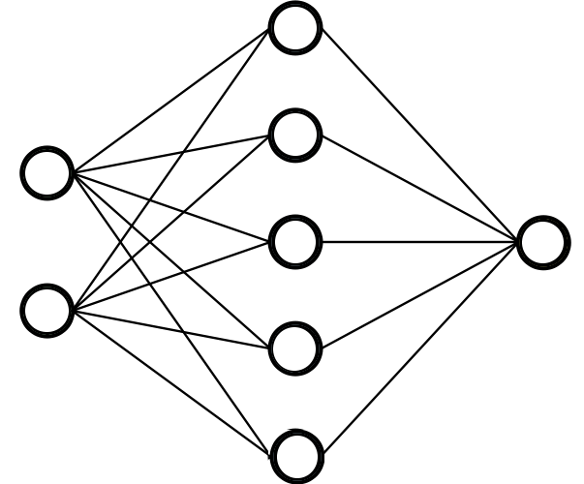

Pattern Recognition Trends & Industry
Industry Tips, Case Studies and Interview Questions
Made by Eng. Essam Wisam

Slide 2
Intended Learning Outcomes
Have a holistic view of the course topics and how they related to each other
Clarify potential next steps for further learning, such as other college courses or MOOCs.
Introduce students to the latest trends in AI, focusing on transformers and how LLMs are built using them
Familiarize students with trending LLM tools, including LangChain, and other tools.
Introduce students to HuggingFace and its applications.
Explain the hiring process and the nature of machine learning roles via actual case studies
Review real interview questions with students to prepare them for job applications.

Slide 3
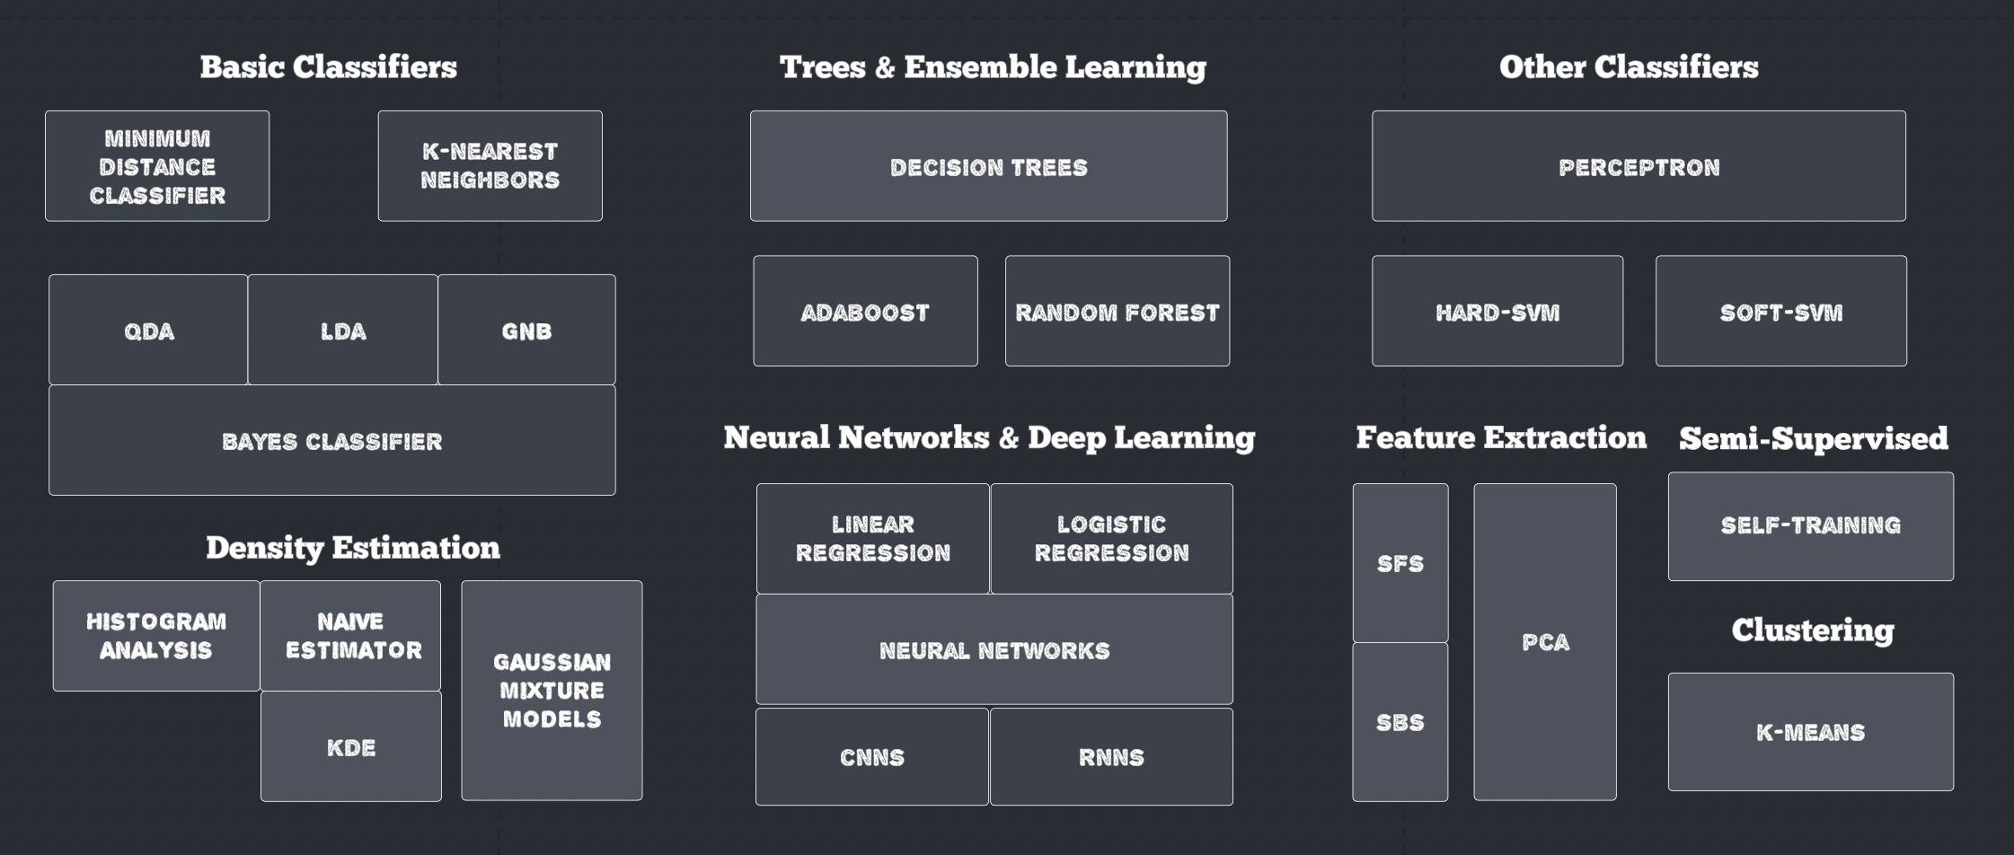
Where We At?
Algorithms Considered in the Lecture (and Tutorial) So Far:

Slide 4
Outstanding Coverage? Get’s Better
Image Processing Course: Feature extraction for computer vision and classical approaches
Machine Learning Course: Theory and mathematics behind concepts such as overfitting, validation and some models
Natural Language Processing Course: Wide coverage of machine and deep learning models where the input or output is text
Satellite Imagery Course: Great coverage of classical and deep computer vision approach (input or output images)
Data Science/Big Data Course: Classical models, table operations, deployment, statistics, etc.
Machine Intelligence Course: Classical AI (e.g., search) and Reinforcement Learning
Cognitive Robotics: Probabilistic and machine learning methods for localization and mapping

Slide 5
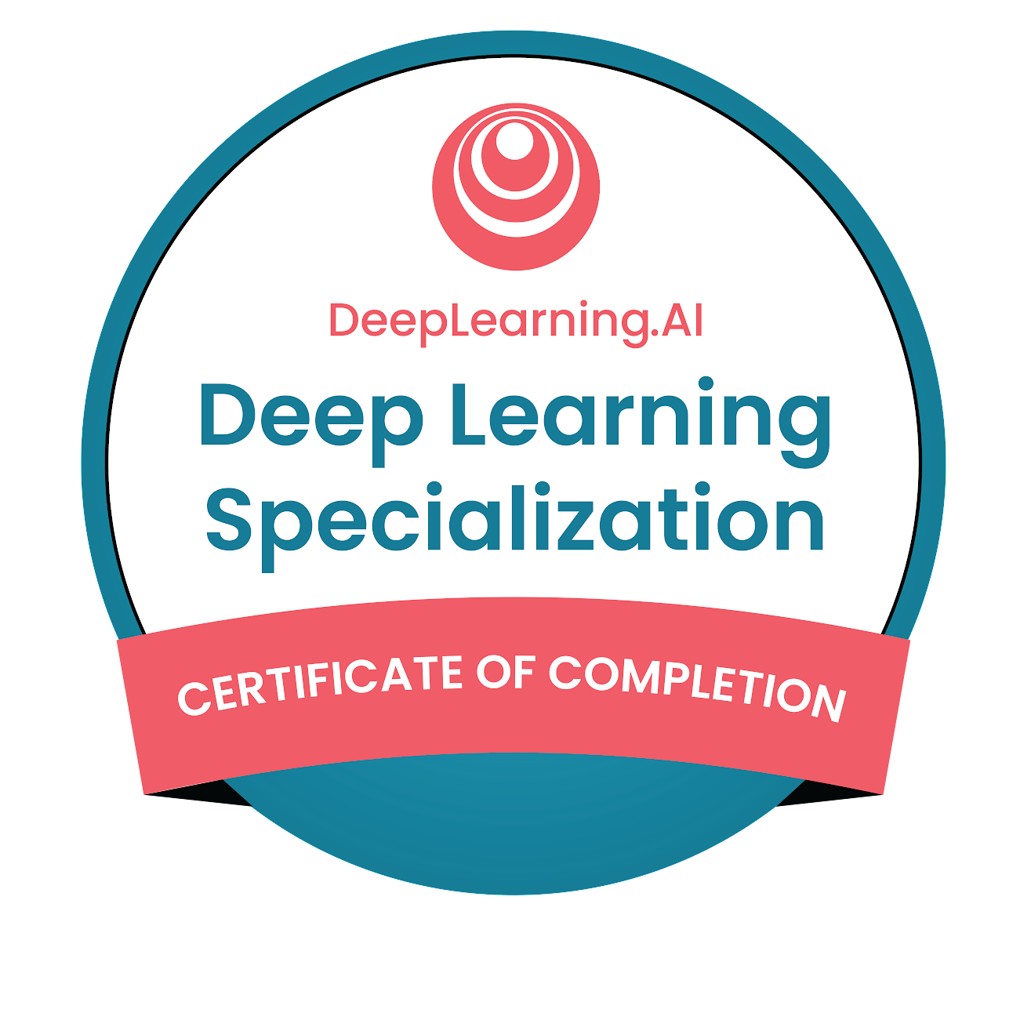

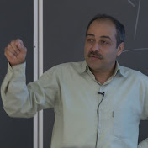

What Now?
Some MooC Recommendations
Five Courses Including CV & NLP
Ultimately Comprehensive + Many Projects
Last course on Recommender Systems and Reinforcement Learning
[Ali Ghodshi on YouTube] Great to understanding the underlying mathematics
Keep up with the Generative AI with LLMs Trend

Slide 6
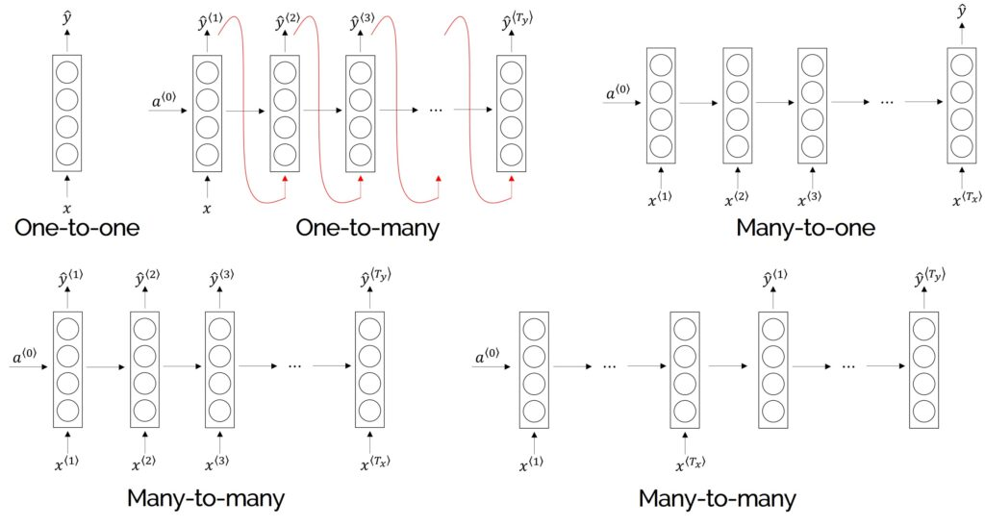
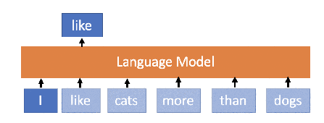
Natural Language Processing
Currently trending in AI
Fundamental Architecture: RNNs (last tutorial)
Generalize FFNN layer to input and output sequences of feature vectors
Sentiment Classification
Personal Word Masking
Text Generation = Classifier
Translation
Summarization

Slide 7

Transformer Model
One-to-one Correspondence to Encoder-Decoder RNNs
First appeared in ”Attention is all you need paper”
Majorly introduces two new blocks: attention and positional encoding
Beats RNN (and its improvements LSTM and GRU) in most if not all tasks
On the left we have the encoder (i.e., like many-to-many or many-to-one RNN)
On the right we have the decoder (i.e., one-to-many)
Authors used it for translation (hence, both are shown)
e.g., BERT
e.g., GPT
e.g., T5

Slide 8
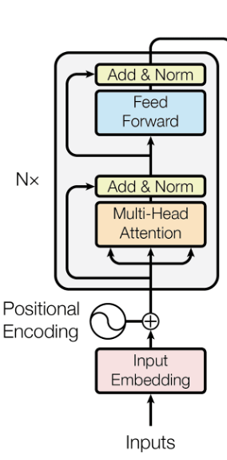
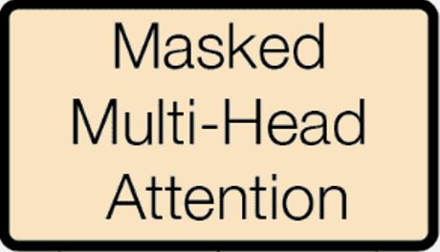
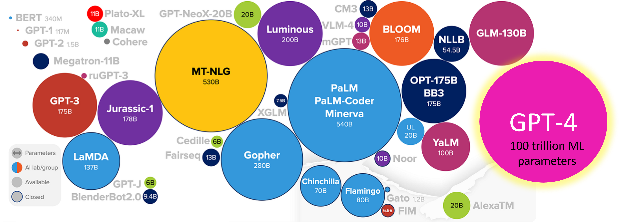
Transformer Model
Turns out transformer decoder is all you need
If you learn to utter text like humans in a wide range of different scenarios
You sound like humans when you utter text involving such scenarios
Problem: combinatorically large number of scenarios but many relationships (learn!)
If it’s trained on big enough data to capture the complexity of uttering text like humans
Model must be “large enough” to handle this (large language model)
Lambda Labs estimated that training ChatGPT on a single GPU would take 355 years. But by exploiting its parallelism, ChatGPT was trained across 25,000 GPUs
SRC

Slide 9
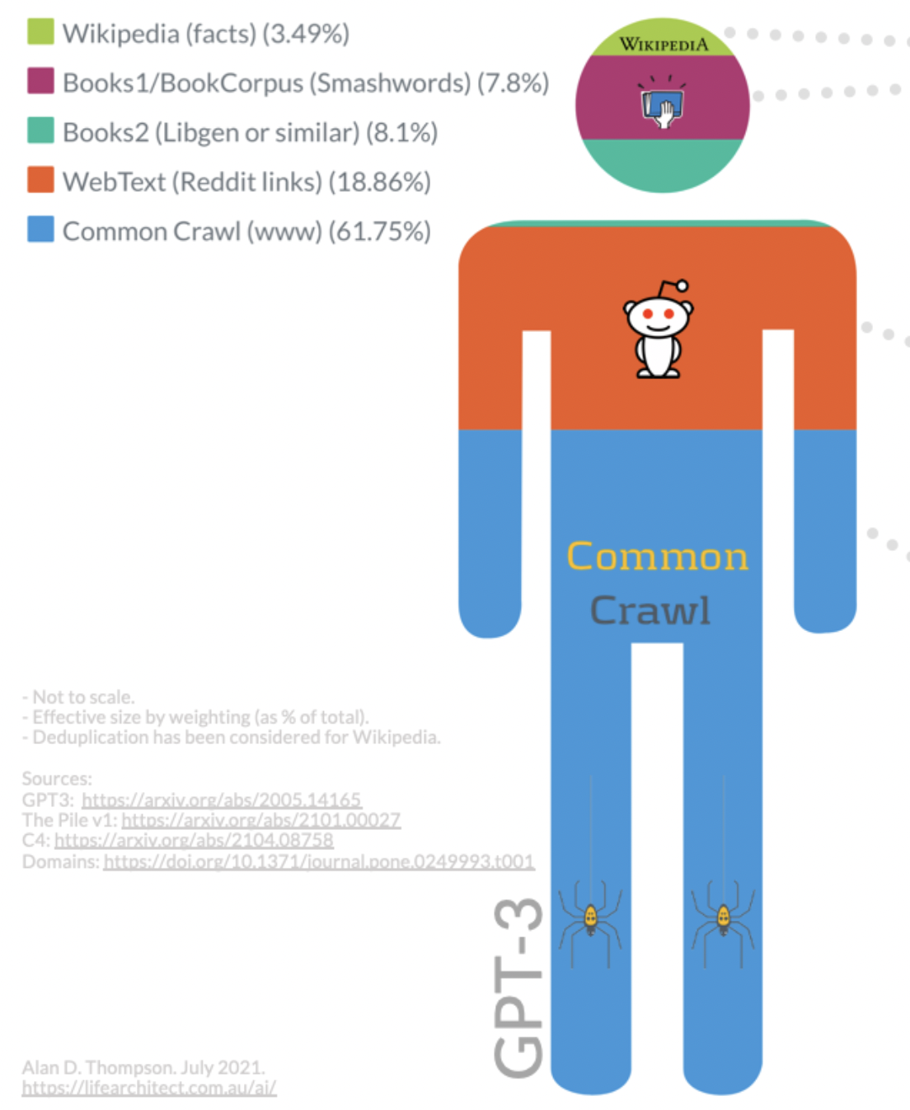
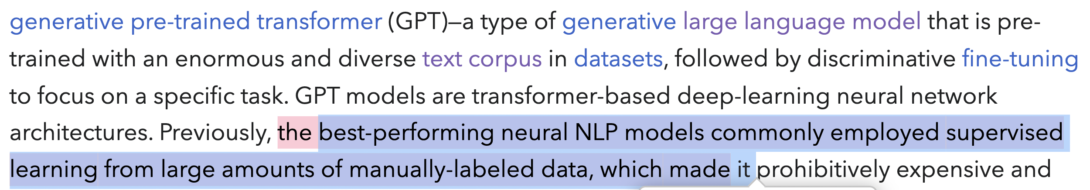
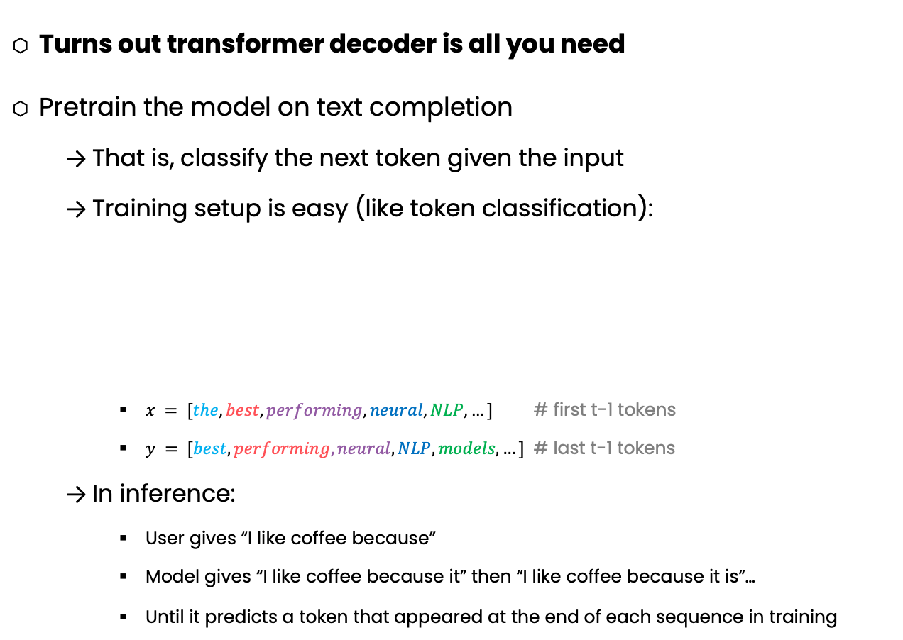
LLM Training Methodology
Turns out transformer decoder is all you need
Pretrain the model on text completion
That is, classify the next token given the input
Training setup is easy (like token classification):
$x = [the, best, performing, neural, NLP,…]$ # first t-1 tokens
$y = [best, performing, neural, NLP, models,…]$ # last t-1 tokens
In inference:
User gives “I like coffee because”
Model gives “I like coffee because it” then “I like coffee because it is”…
Until it predicts a token that appeared at the end of each sequence in training
45TB of Textual Data

Slide 10
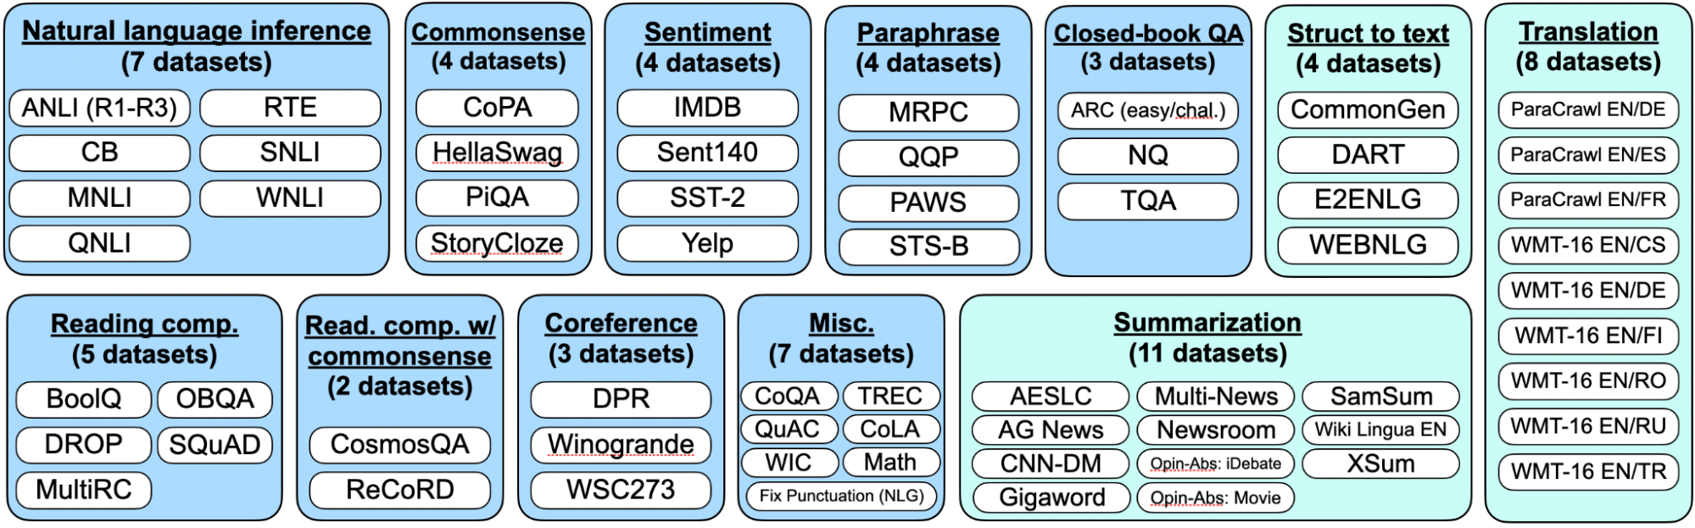
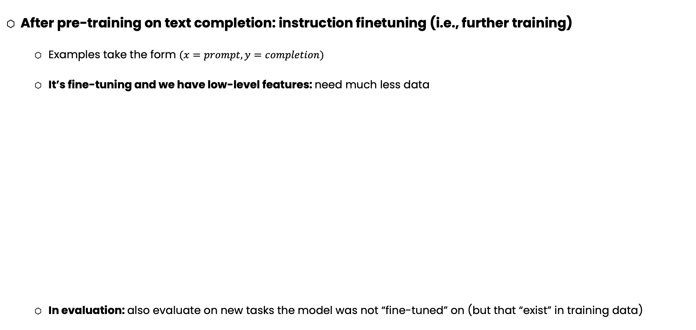
LLM Training Methodology
After pre-training on text completion: instruction finetuning (i.e., further training)
Examples take the form $(x=prompt, y=completion)$
It’s fine-tuning and we have low-level features: need much less data
In evaluation: also evaluate on new tasks the model was not “fine-tuned” on (but that “exist” in training data)

Slide 11
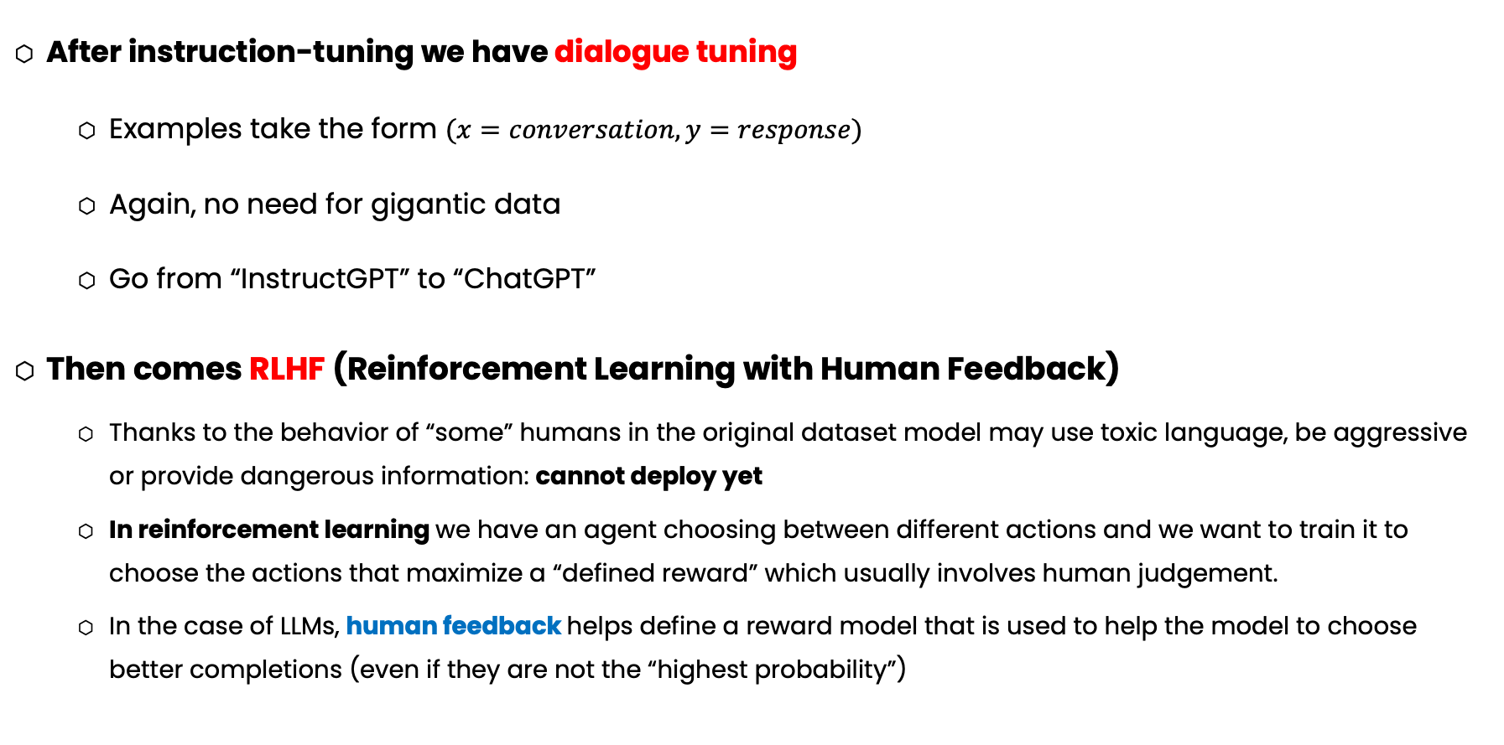
LLM Training Methodology
After instruction-tuning we have dialogue tuning
Examples take the form $(x=conversation, y=response)$
Again, no need for gigantic data
Go from “InstructGPT” to “ChatGPT”
Then comes RLHF (Reinforcement Learning with Human Feedback)
Thanks to the behavior of “some” humans in the original dataset model may use toxic language, be aggressive or provide dangerous information: cannot deploy yet
In reinforcement learning we have an agent choosing between different actions and we want to train it to choose the actions that maximize a “defined reward” which usually involves human judgement.
In the case of LLMs, human feedback helps define a reward model that is used to help the model to choose better completions (even if they are not the “highest probability”)

Slide 12
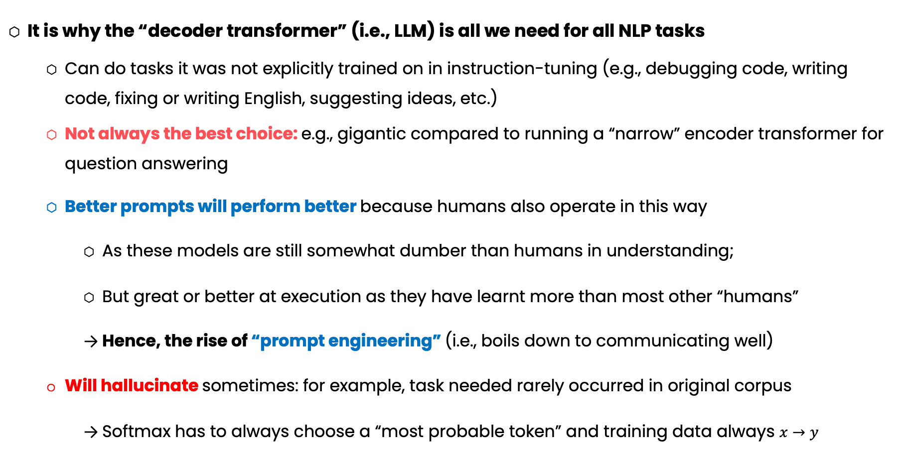
Zero-shot Learning
It is why the “decoder transformer” (i.e., LLM) is all we need for all NLP tasks
Can do tasks it was not explicitly trained on in instruction-tuning (e.g., debugging code, writing code, fixing or writing English, suggesting ideas, etc.)
Not always the best choice: e.g., gigantic compared to running a “narrow” encoder transformer for question answering
Better prompts will perform better because humans also operate in this way
As these models are still somewhat dumber than humans in understanding;
But great or better at execution as they have learnt more than most other “humans”
Hence, the rise of “prompt engineering” (i.e., boils down to communicating well)
Will hallucinate sometimes: for example, task needed rarely occurred in original corpus
Softmax has to always choose a “most probable token” and training data always $x→y$

Slide 13
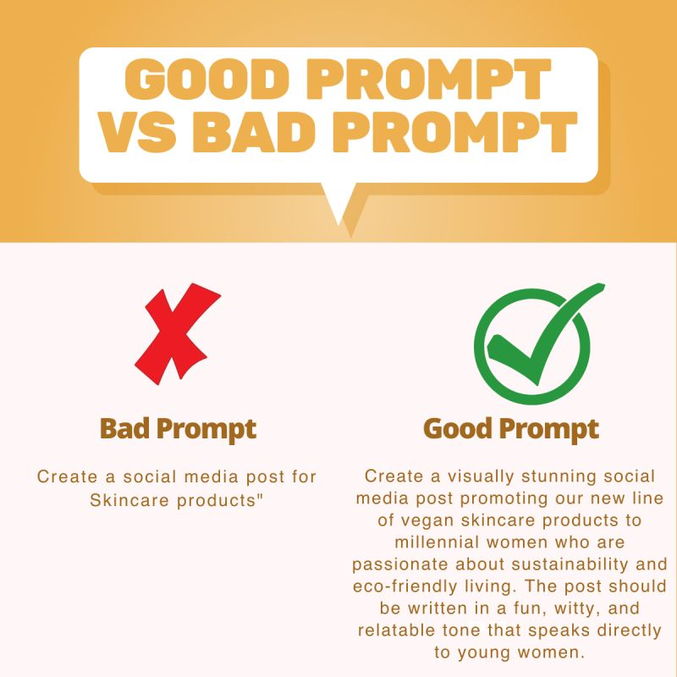
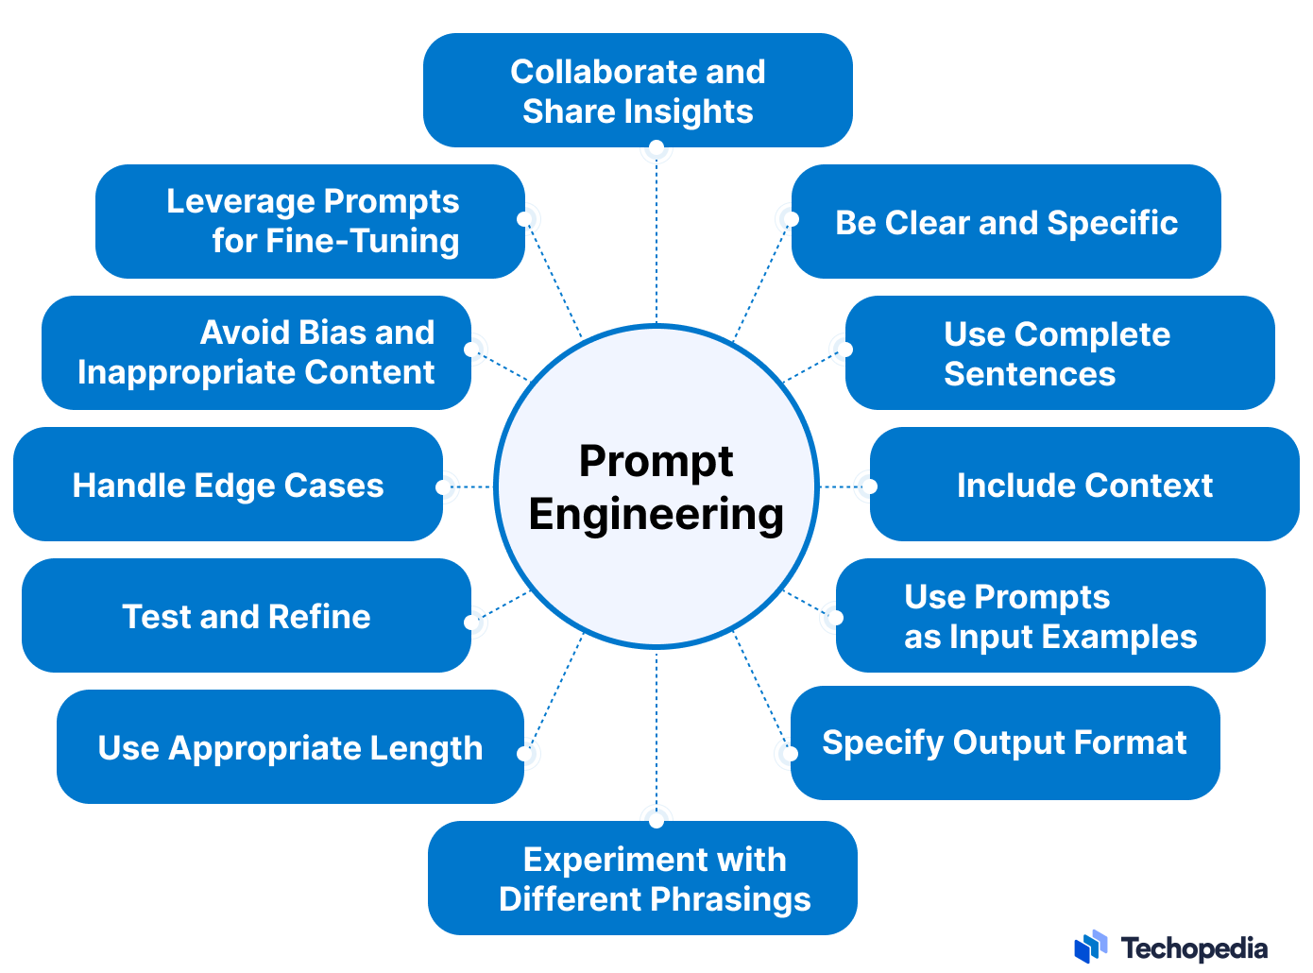
Prompt Engineering
Also known as “communicating well”?

Slide 14
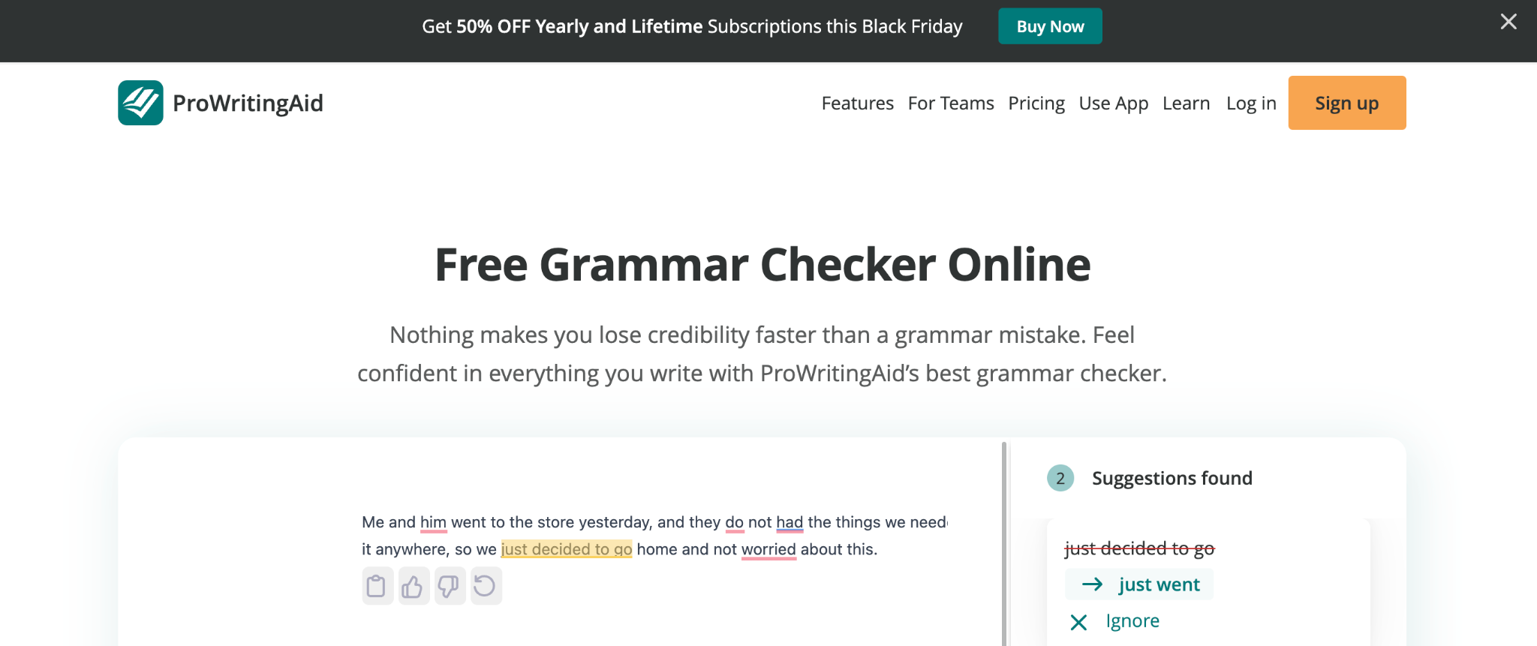
Example Startup
Not Really?
Could Take Months to Build Pre Late 2022
...
Data Collection
Training
Labeling
Tuning

Slide 15
Now: <10 Lines of Code
# 1. import OpenAI package
import openai
# 2. Set your key (it costs to use their LLM)
openai.api_key = ‘CMP20202736137324'
def grammar_check(text):
# 3. Make your prompt template
prompt_template = \
f"""Given the following text, return a json file that maps \
each grammatical error in the text (given by its index) to \
its correction: {text}"""
# 4. Given text from front-end, pass it to OpenAI
response = openai.Completion.create(
engine="gpt-3.5-turbo", prompt=prompt_template,
max_tokens=150,temperature=0.7, n=1,stop=None
)
# 5. Return LLM response (after post-process it)
return response.choices[0].text.strip()
# Example Demo
input_text = "Your input text goes here."
result = grammar_check(input_text)
Now It Takes <10 Lines of Code

Slide 16
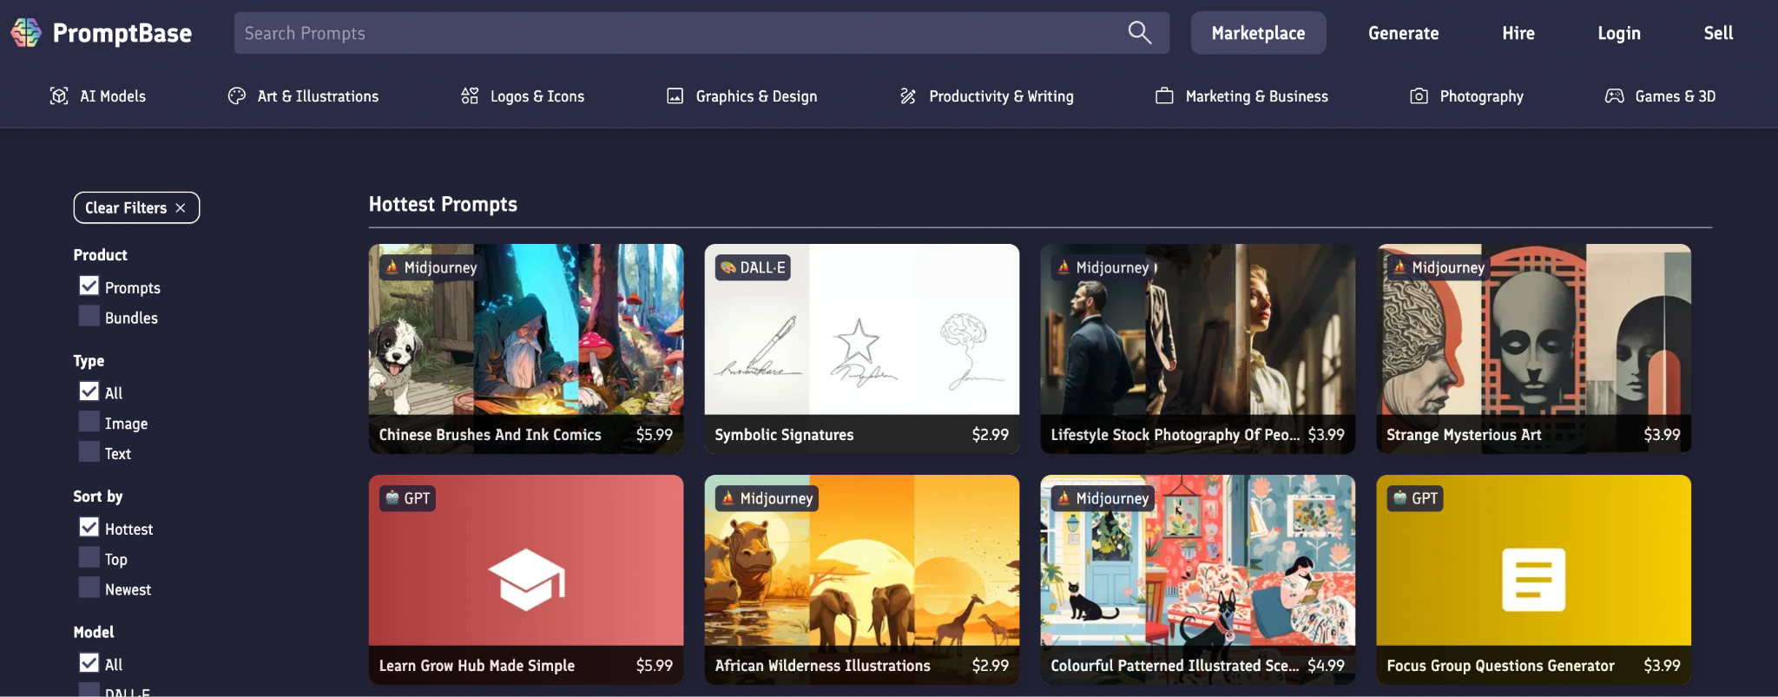
PromptBase
Buy and Sell Dall-E, Midjourney, GPT Prompts!

Slide 17
LangChain
Helps build better LLM pipelines (i.e., chains)
Generally, preprocessing, LLM call, postprocessing but also advanced features like RAG and Agents
from langchain.prompts import PromptTemplate # PromptTemplate
from langchain.llms import OpenAI # LLM
from langchain.schema.output_parser import StrOutputParser # Output Processor
# 1. Create the Prompt
prompt = PromptTemplate.from_template("Convert the following Python code to C++:\n{python_code}\n###")
# 2. Load the LLM
model = OpenAI(model_name="gpt-3.5-turbo-instruct", temperature=0, max_tokens=400)
# 3. Setup an OutputParser
output_parser = StrOutputParser() # Converts the output to string if needed
# 4. Chain them together!
chain = prompt | model | output_parser
# 5. Invoke the chain
print(chain.invoke({"python_code": "print('Hello World')"}))

Slide 18
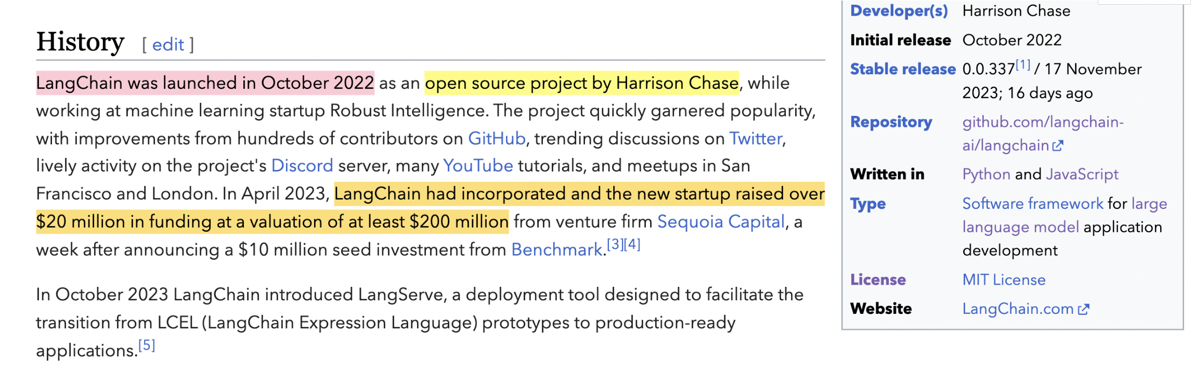
LangChain
Not impressive? First mover advantage; many LLM startups growing
Core features: chains (inc. processing and post-processing), LLM agnostic, agents and RAG
Notes:
Note that despite this many business are turning away from LangChain because it’s not that flexible or stable and it’s not hard to implement the base functionality from scratch (still the most well known LLM pipeline library which is why you have to know about it)

Slide 19
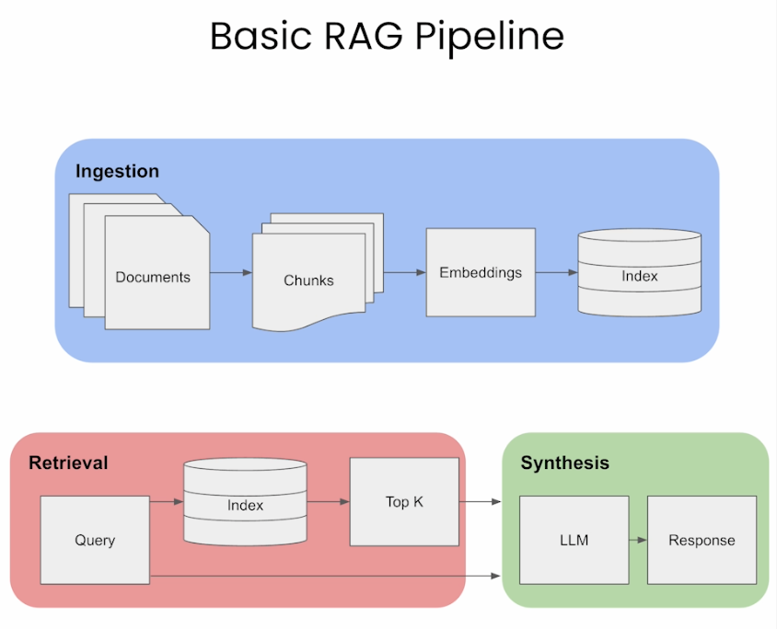
LangChain: RAG
Problem Statement: Want “grounded” LLM responses and no hallucination
Extra block (in red) introduces an extra textual section to the prompt
Use basic NLP technique to find that section (e.g., sentence similarity)
More efficient/performant that inputting the whole resource (e.g., book)
Reference

Slide 20
LangChain: RAG
Problem Statement: Want “grounded” LLM responses and no hallucination
# 2. Declare the Model
llm = OpenAI()
# 3. Define a custom function to concatenate the chunks
def format_docs(top_k_chunks):
...
# 0. Setup Retriever
retriever = ...
# 1. Prepare prompt
template = """Use the following 3 pieces of context to answer the question at the end.
Use three sentences maximum and keep the answer as concise as possible and be honest and say I don't know when you need to.
{context}
Question: {question}
Helpful Answer:"""
prompt = PromptTemplate.from_template(template)
# 4. Declare the RAG chain
rag_chain = (
{"context": retriever | format_docs, "question":RunnablePassthrough()}
| prompt
| llm
| StrOutputParser()
)
# 5. Use the RAG chain
rag_chain.invoke(”Who was the first king of Egypt?")

Slide 21
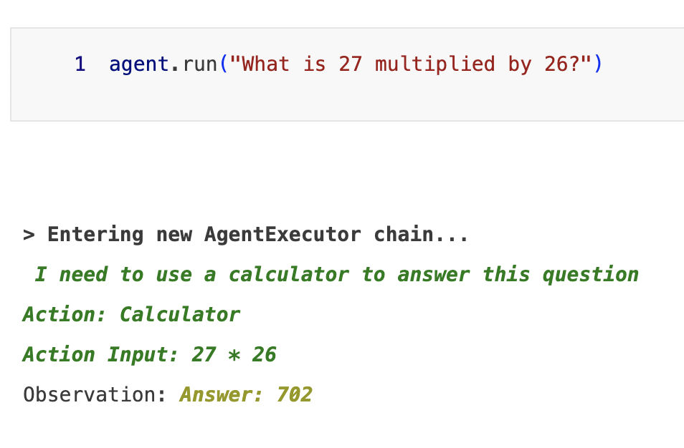
LangChain: Agents
Problem Statement: Want LLMs to be able to call tools and use output from them!
# 1. Define the tools (some need LLMs; e.g., math)
tools = [
Tool(
name = "Search",
func=SerpAPIWrapper().run,
description="useful for current event questions"
),
Tool(
name="Calculator",
func=LLMMathChain(llm=OpenAI(temperature=0)).run,
description="useful for math questions",
return_direct=True
),
Tool(
name="Music Search", # Custom dummy tool
func=lambda x: ”Example Song.",
description="A Music search engine
)
]
# 2. Define LLM
llm = OpenAI(temperature=0)
# 3. Wrap tools and LLM in an agent!
agent = initialize_agent(tools, llm, agent="zero-shot-react-description", verbose=True)

Slide 22
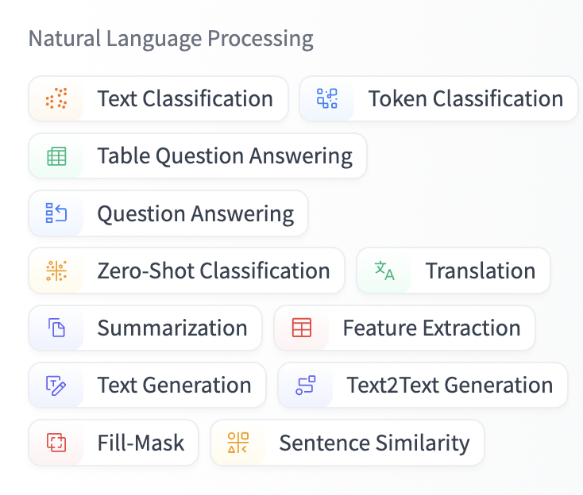
Back to NLP: HuggingFace
For many problems, using a generic LLM could be too expensive and it’s better to use a smaller model (encoder or encoder-decoder)
🤗 HuggingFace (package and website) houses a large range of pretrained NLP (and CV) models
Usually get pretrained model then fine-tune it on a custom task
As we saw before for CV, much better that training from scratch
Let’s have a real demo by navigating to their website.

Slide 23
Back to NLP: HuggingFace
For many problems, using a generic LLM could be too expensive and it’s better to use a smaller model (encoder or encoder-decoder)
🤗 HuggingFace (package and website) houses a large range of pretrained NLP (and CV) models
Usually get pretrained model then fine-tune it on a custom task
As we saw before for CV, much better that training from scratch
Let’s see their website.
Models are in PyTorch/TensorFlow (mostly PyTorch) so no need to learn new syntax (just some high-level functions)

Slide 24
HuggingFace Example
import torch
from transformers import DistilBertTokenizer, DistilBertForSequenceClassification
tokenizer = DistilBertTokenizer.from_pretrained("distilbert-base-uncased-finetuned-sst-2-english")
model = DistilBertForSequenceClassification.from_pretrained("distilbert-base-uncased-finetuned-sst-2-english")
inputs = tokenizer("Hello, my dog is cute", return_tensors="pt")
with torch.no_grad():
logits = model(**inputs).logits
predicted_class_id = logits.argmax().item()
model.config.id2label[predicted_class_id]

Slide 25








ML Industry in Egypt
Certainly Not Comprehensive
Let’s learn more about the ML industry through some case studies [Rest of Slides Only Available to Students]

Slide 26
Thank You

